Slide 1



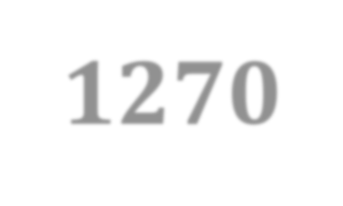





PUB 1270
Socio-political Environment
Tutorial 01
Department of Public Administration Faculty of Management Studies & Commerce University of Sri Jayewardenepura

Slide 2

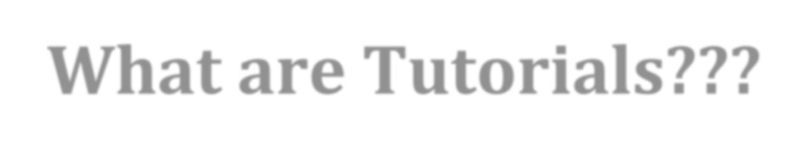
What are Tutorials???
Tutorial class is an important teaching-learning tool
It is highly a student- centered
It provides you interactive sessions
It just like a revision session
It is a good platform to discuss applications of learnt theoretical knowledge

Slide 3

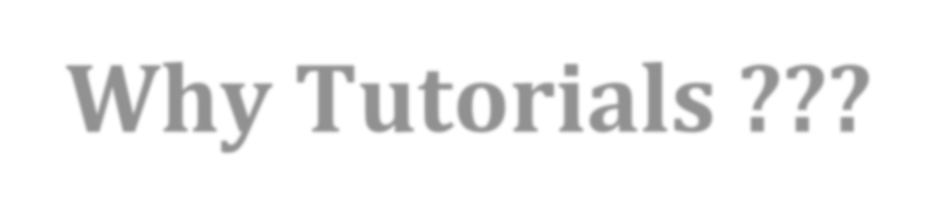
Why Tutorials ???
To provide you the opportunity to improve your soft skills
What are soft skills??
To guide you for the successful completion of continuous assessments
To provide you better understanding on evaluation schemes
To clarify your confusions and questions
To discuss applications and examples of theoretical knowledge gathered in
lectures
To discuss review questions
To train you for the final examination

Slide 4


Scheme of Evaluation
Activity | Weight
Continuous Assessments | 30%
Final Examination | 70%
Total | 100%
More details on Continuous Assessments
Continuous Assessment I – 20% Continuous Assessment II – 10%

Slide 5
Continuous Assessment I – Group Presentation (20 Marks)
Group presentations will be commenced from the 2nd week onwards. Students are expected to do a 15 minutes presentation on a pre-assigned topic. For this purpose, mini groups will be formed at the beginning of the semester. Two group presentations will be evaluated during the tutorial class of each week.
Continuous Assessment II – Assessment for the Non- Presenters (10 Marks)
Every group other than the two presentation groups of a particular day are expected to provide one – page answer script explaining their evaluation of one of the presentations done on the day. Also, in the same answer script, you need to explain the content you would include, if you were given the same topic to do the presentation.

Slide 6
Further Guidelines to the Weekly Group Presentations

Slide 7
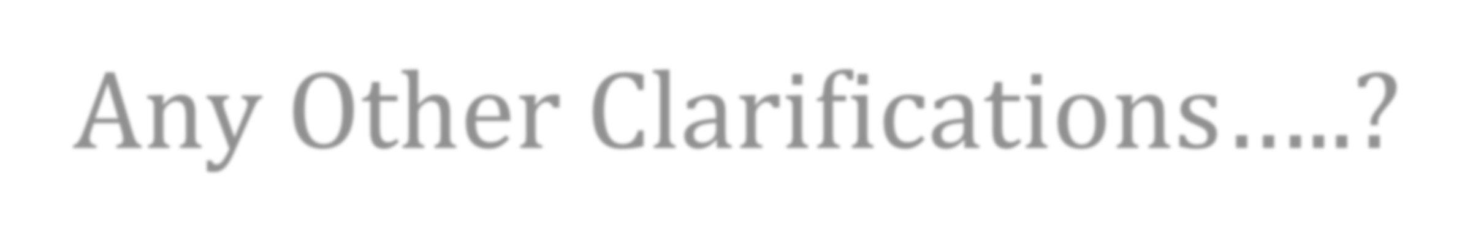
Any Other Clarifications…..?

Slide 8

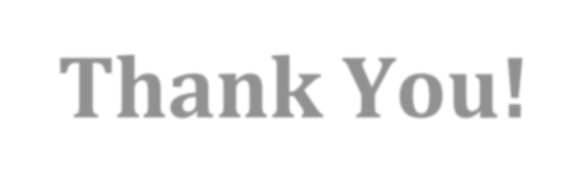
Thank You!

